Slide 1
Basic ETL & Reporting Tool
Hadi Lotfy
16th Sep 2024

Slide 2
Who is the Presenter?
Computer Systems and Control Engineer
ITI Dot Net Training
ITI Embedded Systems Training
Machine Learning (ASR) Grad. project
ITI DevOps Trainee
AWS Solution Architect Associate - SAA
Technical Operation Engineer - CashCall
Profiles: DevOps, SRE, Sys Admin, Cloud Engineer

Slide 3
Agenda
The Presenter
Agenda
Delivery Requirements
Meeting Requirements
Key Features
Future work and Q&A

Slide 4
Requirements
Python 3.x
Functionality:
Reads from some specific SQLite db.
Dumps data into CSV and JSON files.
Generates a report based on the dumped files.
Code structure.
Documentation and comments.
Robustness and error handling.
Efficiency and optimization of the code.
Easily runnability on any environment.

Slide 5
Meeting Requirements
End User Experience
Diagrams
Package Diagram
Class Diagrams
Code Snippets

Slide 6
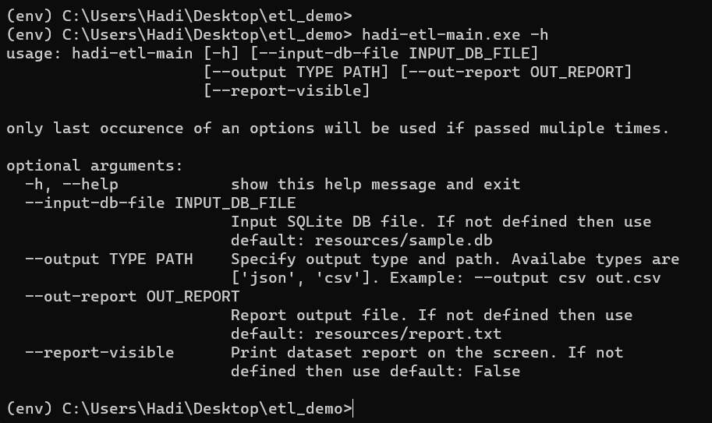
Meeting Requirements: User Experience (1/2)

Slide 7
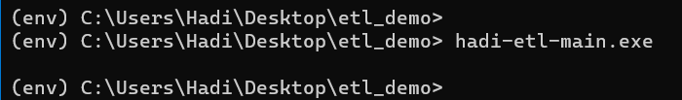
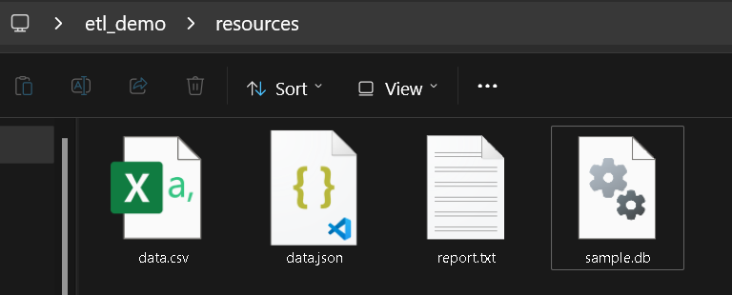
Meeting Requirements: User Experience (2/2)

Slide 8
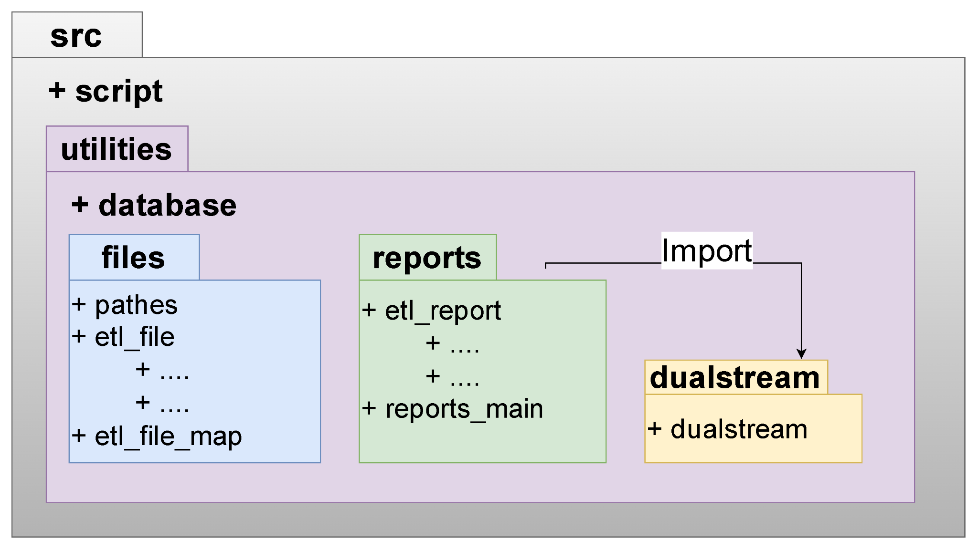
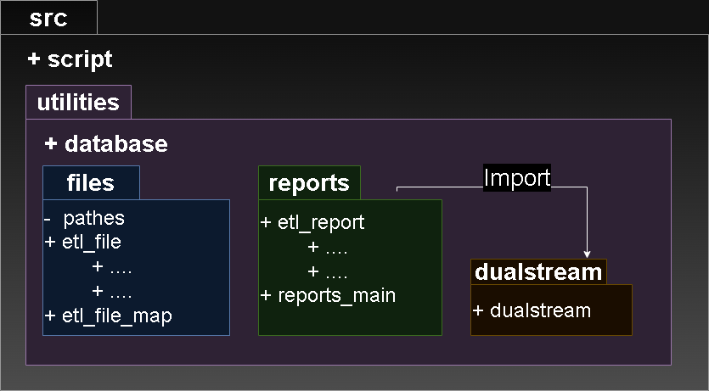
Meeting Requirements: Package Diagram
Packages contents are modules

Slide 9
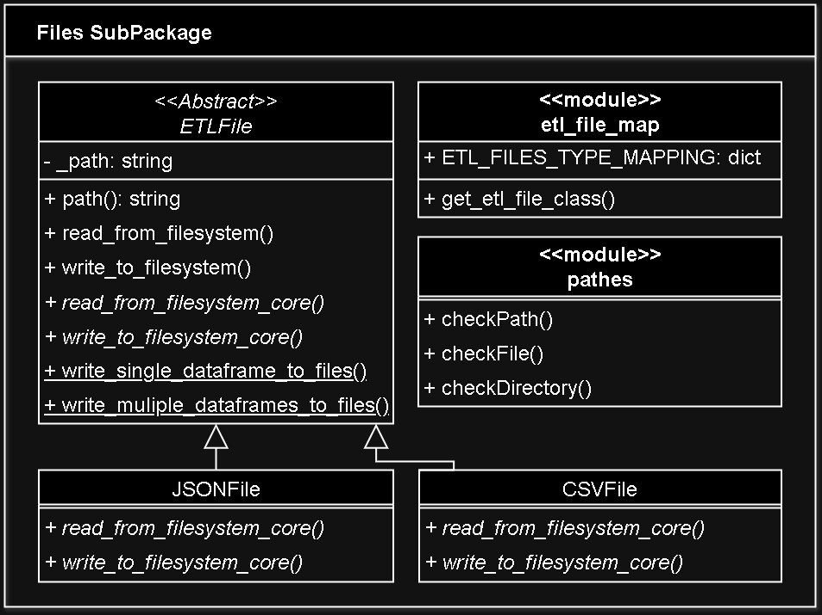
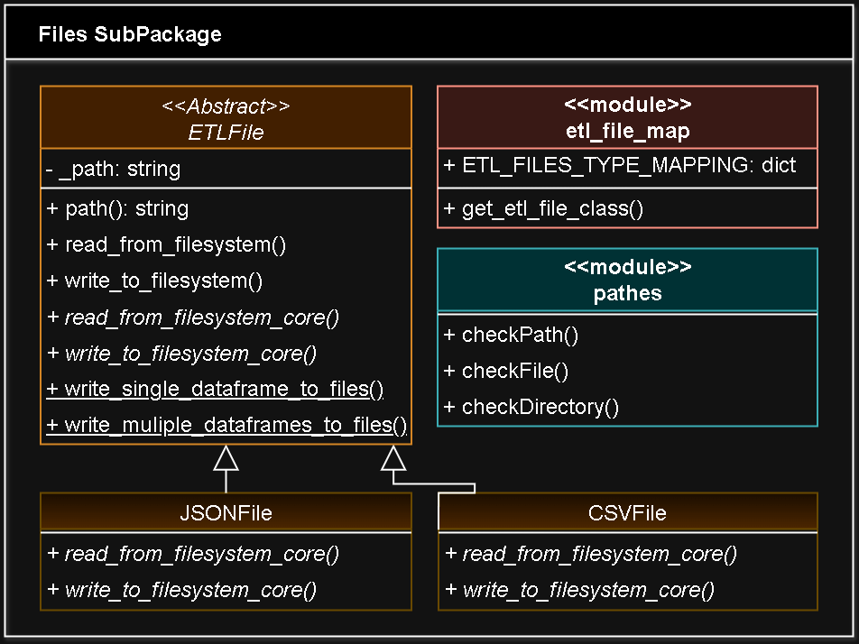
Meeting Requirements
: Files SubPackage

Slide 10
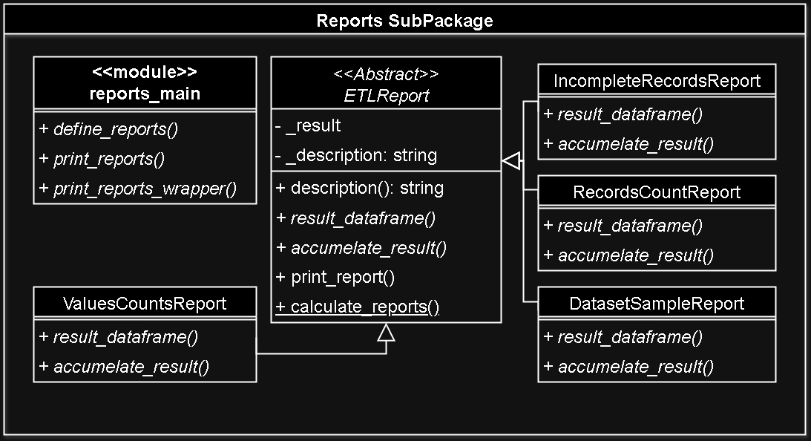
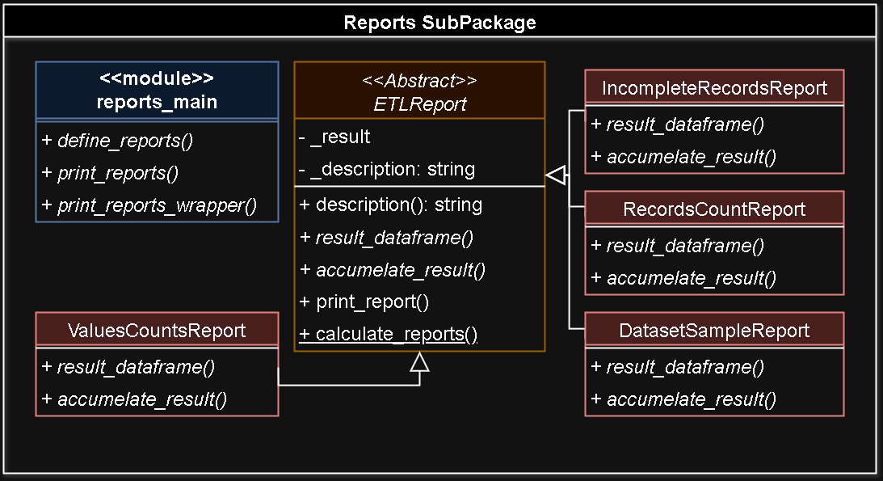
Meeting Requirements: Reports SubPackage

Slide 11
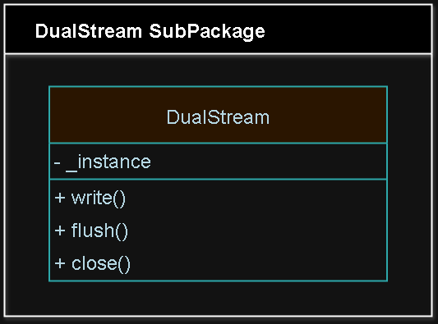
Meeting Requirements: DualStream SubPackage

Slide 12
Requirements
Python 3.x
Functionality:
Reads from some specific SQLite db.
Dumps data into CSV and JSON files.
Generates a report based on the dumped files.
Code structure.
Documentation and comments.
Robustness and error handling.
Efficiency and optimization of the code.
Easily runnability on any environment.

Slide 13
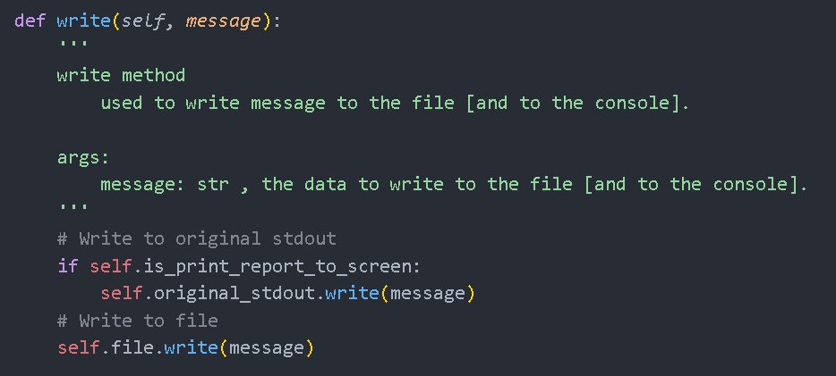
Meeting Requirements: Docs. and Comments

Slide 14
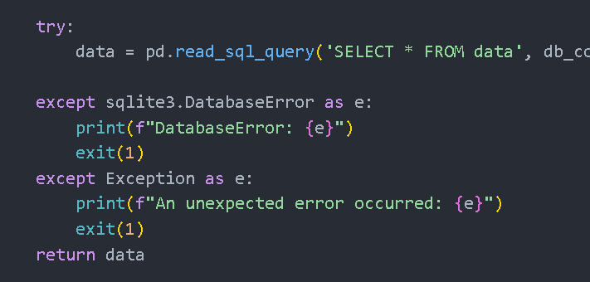
Meeting Requirements: Error Handling (1/2)

Slide 15
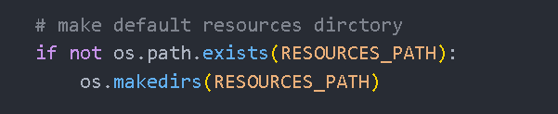
Meeting Requirements: Error Handling (2/2)

Slide 16
Meeting Requirements: Efficiency (1/2)
Pandas DataFrame Chunking.
Initialize Chunks.
No memory usage for now.
Loop through chunks to retrieve data.
In the Loop: this is where Data flows into our program.
Only one chunk is loaded into memory.

Slide 17
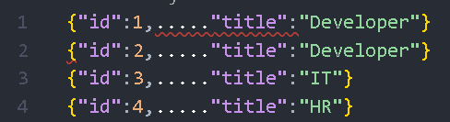
Meeting Requirements: Efficiency (2/2)
JSON Records VS JSON Object/Array

Slide 18
Meeting Requirements: Runability
CLI Tool.
Requirements file.
Packaging using (setup.py).
Clear and Simple installation instructions.

Slide 19
Requirements
Python 3.x
Functionality:
Reads from some specific SQLite db.
Dumps data into CSV and JSON files.
Generates a report based on the dumped files.
Code structure.
Documentation and comments.
Robustness and error handling.
Efficiency and optimization of the code.
Easily runnability on any environment.

Slide 20
Key features
Modular Structure with OOP Utilization.
Data Chunking.
Memory Efficient.
Code Reusability.
Customizable Reporting.
CLI Tool.
Packaged for easy install.

Slide 21
Possible Future Improvements
Unified abstract parent class for data sources.
Make error handling more structured and standardized.
Add Logging Capabilities.
Adding unit test cases.
Automate testing against Python versions and dependencies versions.

Slide 22
Questions

Slide 23
Thanks

Slide 24
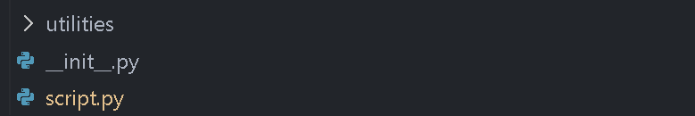
Python Packages Structure: src base

Slide 25
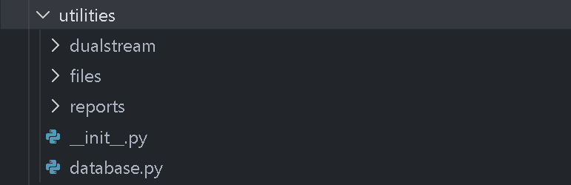
Python Packages Structure: utilities package

Slide 26
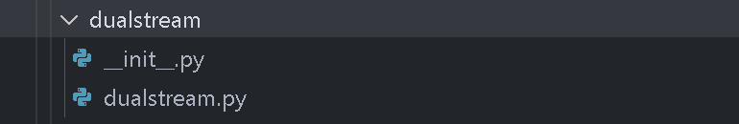
Python Packages Structure: utilities.dualstream subpack.

Slide 27
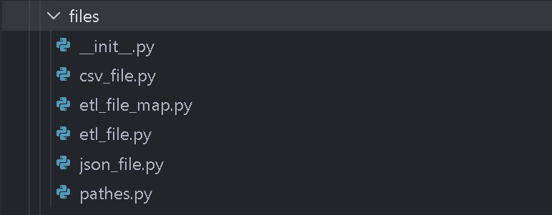
Python Packages Structure: utilities.files subpackage

Slide 28
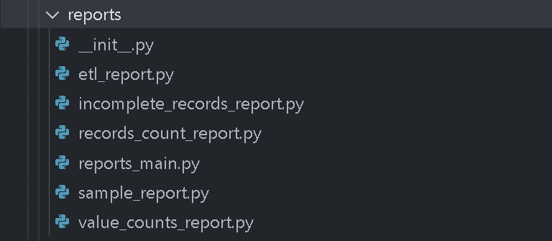
Python Packages Structure: utilities.reports subpackage

